Slide 1
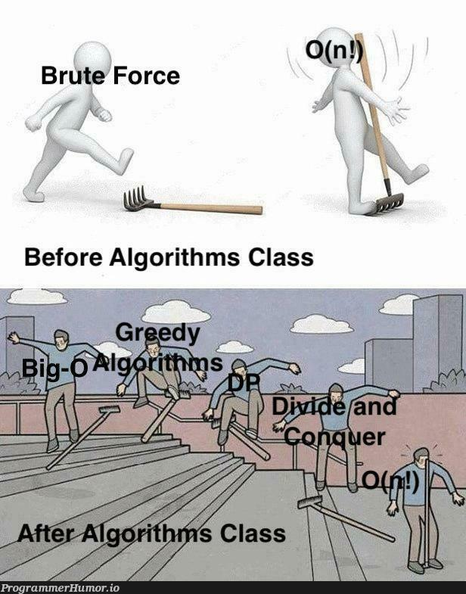
DAA TSC
Idk what to add here

Slide 2
Random Question
Given a string of ‘a’s and ‘b’s, find the number of substrings such that the number of ‘a’s is less than the number of ‘b’s.

Slide 3
What all can balanced bsts store?
each node x stores the number of nodes in the subtree rooted at x
each node x stores the number of nodes larger than x
each node x stores its distance from the root
each node x stores a pointer to its successor (that is the smallest number larger than x)
each node x stores the largest depth of a node in the subtree rooted x
each node x stores its rank in the BST
Even though rank and number of nodes larger than x can’t be stored, these can be queried in O(log n)

Slide 4
FFT and where to use it
Understand the circuit representation of FFT
Look out for convolutions, I visualise them as a sliding dot product
Convolutions are FFT -> element wise multiplication -> Inverse FFT
Charges question (last one in Arithmetic tut)

Slide 5
Dynamic Programming
How to think of a dp solution?
Take cases on how a solution will look like, partition the solution based on the root of the tree, the beginning subsequence of the array, the first choice you make, etc
Given a string x consisting of 0s and 1s, we write x to denote k copies of x concatenated together. We say that a string x' is a repetition of x if it is a prefix of x^k for some number k.
So x' = 10110110110 is a repetition of x = 101. We say that a string s is an interleaving of x and y if its symbols can be partitioned into two (not necessarily contiguous) subsequences s' and s", so that s' is a repetition of x and s" is a repetition of y.
Given s, x, y, design an efficient algorithm to check if s is an interleaving of x,y.

Slide 6
Dynamic Programming
Given a string A of length n, and strings B1, B2, …, Bk each of length m.
Find the smallest edit distance between A and a concatenation of Bi’s.

Slide 7
Greedy Algos, How to Prove
“It's easy to invent greedy algorithms for almost any problem; finding cases in which they work well, and proving that they work well, is the interesting challenge.” – Tardos
2 main ideas to prove greedy algos:
  1. Show that the greedy algorithm always stays ahead. At every iteration, it does the same thing as some optimal solution (interval scheduling)
  2. Exchange argument. Given an optimal solution, modify it step by step without hurting the optimality, until you get a solution which matches the one outputted by the greedy algorithm (minimizing maximum lateness)
If you’re not sure of if your greedy algorithm is correct, think about how would a counterexample look, and construct one based on how the heuristic of the algorithm isn’t correct

Slide 8
Greedy Algos, How to Prove
In a movie festival, n movies will be shown. Your movie club consists of k members, who will be all attending the festival.
You know the starting and ending time of each movie. What is the maximum total number of movies the club members can watch entirely if they act optimally?

Slide 9
Greedy Algos, How to Prove
Given a set of contestants for a mini-triathlon (swim 20 laps, bike 10 miles, run 3 miles), each with projected times for each segment, determine the optimal order to minimize the competition’s total completion time. Only one contestant can swim at a time, but biking and running can overlap. Design an efficient scheduling algorithm.

Slide 10
Greedy Algos, How To Prove
From exercise sheet
Suppose you are an advertisement company who wants to advertise something to all n people in the city. You know that each of these n people will come to the city center on Sunday for some interval of time. You have acquired these time intervals for all people through some unethical means. You cannot put ads at the city center, but you can pay people to carry your ad on them (maybe by wearing a t-shirt). Assume that if X is carrying the ad, then anyone whose time interval intersects with the time interval of X will see the ad (of course, X will also see the ad). You want to choose minimum number of people to whom you should pay so that everyone sees the ad. Design an algorithm for this and prove its correctness.

Slide 11
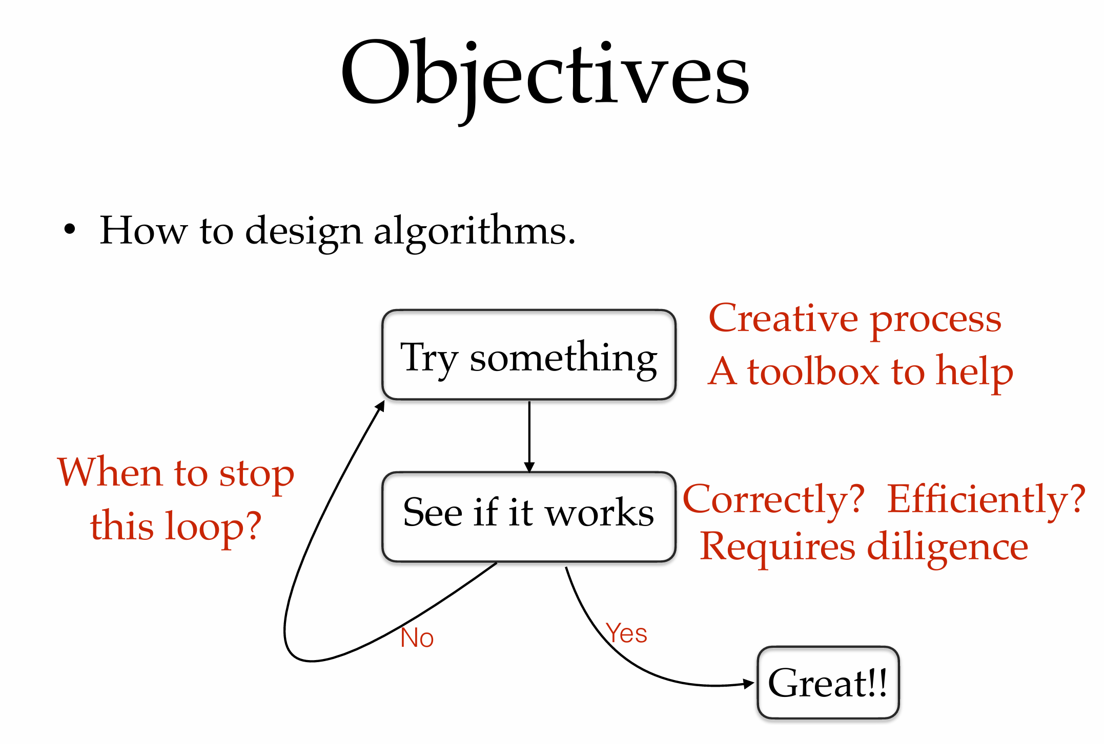
Add this to cheat sheet

